Slide 1
Market Analysis of Small Businesses in Toronto
April 12, 2020
Byron Seppala

Slide 2
Agenda
Introduction
Data
Exploratory Analysis
Methodology
Results
Discussion
Conclusion

Slide 3
Introduction
What makes a small business succeed?
Management
Marketing
Location
Capturing market demand
Who needs to know?
Investors
Loan officers
Other investors
City planners
Consultants

Slide 4
Data
Sources
Wikipedia
Scraped to collect Toronto postal codes and neighborhoods
Foursquare
Accessed to collect venue data around Toronto neighborhoods
Cleaning
Unassigned postal codes dropped
If multiple neighborhoods assigned to one postal code, neighborhoods are taken as a group
Postal codes and neighborhoods merged with geographical coordinates

Slide 5
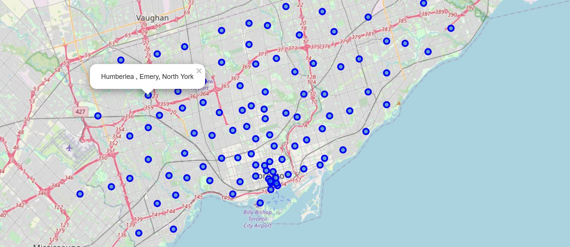
Exploratory Analysis
This interactive map of Toronto neighborhoods shows geographical location. By clicking on the nodes (in the Jupyter Notebook), one can discover the neighborhoods and borough that the node represents.

Slide 6
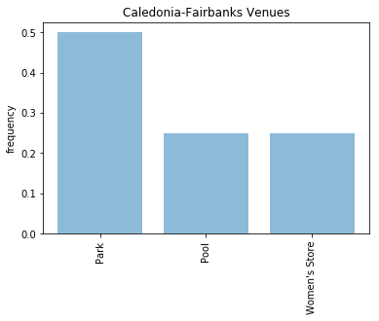
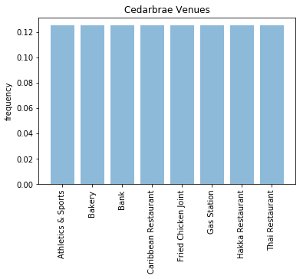
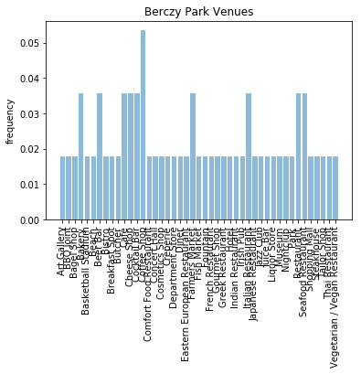
Exploratory Analysis
These graphs show the frequency distribution of venues in three Toronto neighborhoods.

Slide 7
Methodology
K-Means Clustering
Used to identify similar neighborhoods
Cluster model fit using dataset that leaves the target category out
Dual Ranking
Used to identify “typical” neighborhoods by ranking them by distance from cluster mean
Used to identify neighborhoods that lack venues corresponding with the target category*
*Target category is the category of interest. E.g. coffee shops

Slide 8
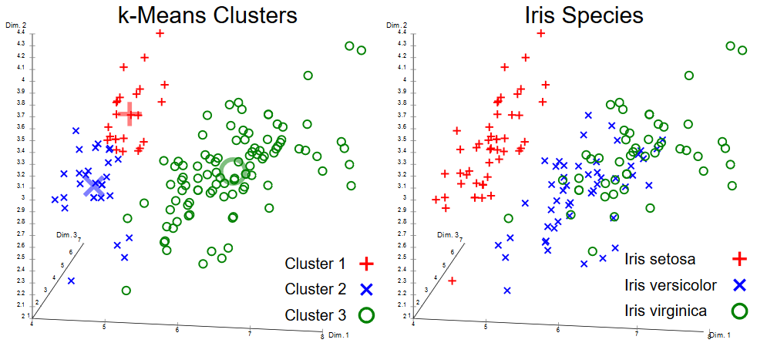
Methodology
Example of k-means clustering, source: https://en.wikipedia.org/wiki/K-means_clustering#/media/File:Iris_Flowers_Clustering_kMeans.svg

Slide 9
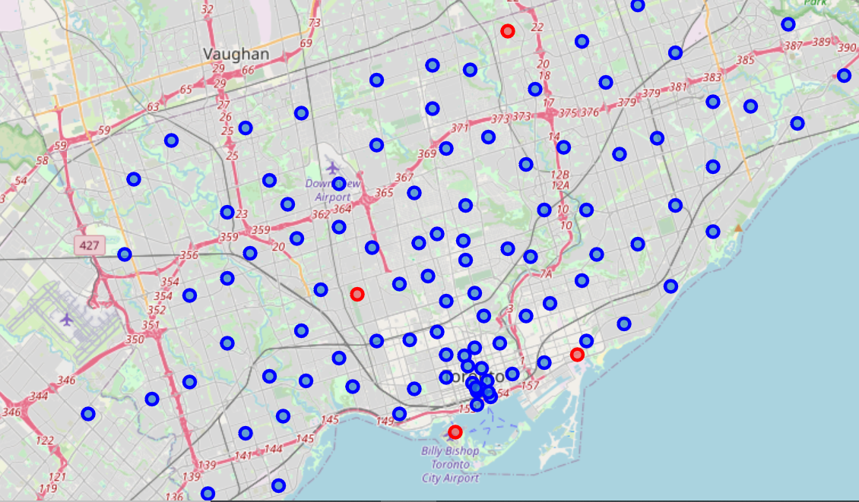
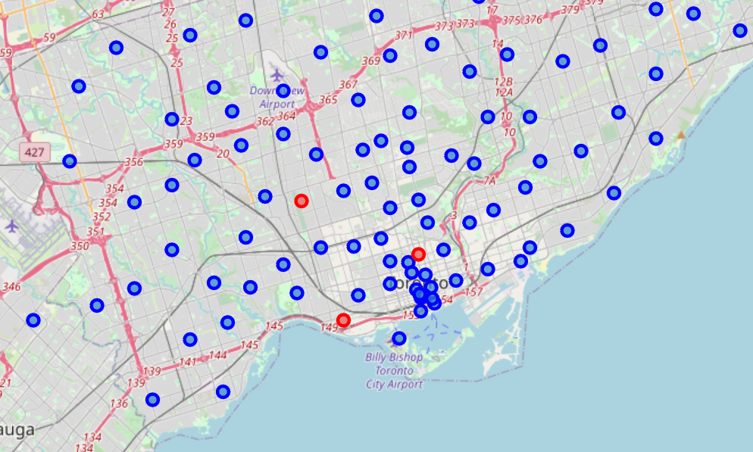
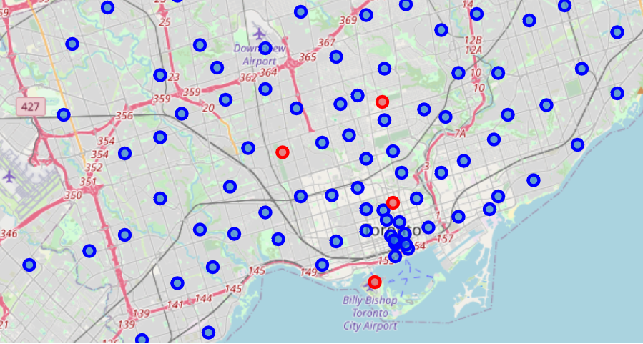
Results
Applying the cluster model and dual ranking yields a list of the “ideal” locations for starting certain types of businesses
Ideal Coffee Shop Locations Ideals Bagel Shop Locations Ideal Nightclub Locations

Slide 10
Conclusion
Using k-means clustering and ranking, this model provides users with a list of suggested locations for various business types
This model assumes that preferences and consumption patterns are stable across neighborhoods
The evidence provided by this model could prove useful for:
Investors interested in the viability of businesses
City planners considering urban renewal projects or zoning changes
Consultants looking to improve the profitability of their clients

